Slide 1

Applied Mathematics – I
University of Diyala College of Engineering Dep. of Civil Engineering
2nd Stage
Dr. Huda M. Mubarak

Slide 2
Analytic Geometry
Rectangular Coordinates
The points in a plane may be placed in one-to-one correspondence with pairs of real numbers. A common method is to use perpendicular lines that are horizontal and vertical and intersect at a point called the origin. These two lines constitute the coordinate axes; the horizontal line is the x-axis and the vertical line is the y-axis. The positive direction of the x-axis is to the right, whereas the
positive direction of the y-axis is up.
Thus, point P is associated with the pair of real numbers (x₁, y₁) and is denoted P(x₁, y₁). The coordinate axes divide the plane into quadrants I, II, III, and IV.
Distance between Two Points; Slope
The distance d between the two points P₁(x₁, y₁) and P₂(x₂, y₂) is
𝑑 = √(𝑥₂ − 𝑥₁)² + (𝑦₂ − 𝑦₁)²
In the special case when P₁ and P₂ are both on one of the coordinate axes, for instance, the x-axis,
𝑑 = √(𝑥₂ − 𝑥₁)² = |𝑥₂ − 𝑥₁|
or on the y-axis,
𝑑 = √(𝑦₂ − 𝑦₁)² = |𝑦₂ − 𝑦₁|
The midpoint of the line segment P₁P₂ is
(
𝑥₁ + 𝑥₂ 𝑦₁ + 𝑦₂
, )
2 2
The slope of the line segment P₁P₂, provided it is not vertical, is denoted by m and is given by
𝑚 =
𝑦₂ − 𝑦₁
𝑥₂ − 𝑥₁

Slide 3
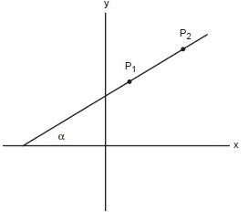
The slope is related to the angle of inclination α by
𝑚 = tan 𝛼
Two lines (or line segments) with slopes m₁ and m₂ are perpendicular if m₁= -1/m₂
and are parallel if m₁ = m₂.
Equations of Straight Lines
A vertical line has an equation of the form
x = c
where (c, 0) is its intersection with the x-axis. A line of slope m through point (x₁, y₁) is given by
𝑦 − 𝑦₁ = 𝑚(𝑥 − 𝑥₁)
Thus, a horizontal line (slope = 0) through point (x₁, y₁) is given by
y = y₁
A nonvertical line through the two points P₁(x₁, y₁) and P₂(x₂, y₂) is given by either
𝑦 − 𝑦₁ = _{𝑥}
𝑦₂ − 𝑦₁
(𝑥 − 𝑥₁)
− 𝑥
Or
2 1

Slide 4
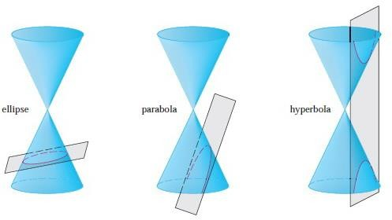
𝑦 − 𝑦₂ = _{𝑥}
𝑦₂ − 𝑦₁
(𝑥 − 𝑥₂)
− 𝑥
2 1
Circle
The general equation of a circle of radius r and center at P(x₁, y₁) is
(𝑥 − 𝑥₁)² + (𝑦 − 𝑦₁)² = 𝑟²
Conic Sections
The conic sections are called conics because they result from intersecting a cone with a plane as shown in figure
Parabola
A parabola is the set of all points (x, y) in the plane that are equidistant from a given line called the directrix and a given point called
the focus. The parabola is symmetric about a line that contains the focus and is perpendicular to the directrix. The line of symmetry intersects the parabola at its vertex. The eccentricity e = 1.
We obtain a particularly simple equation for a parabola if we place its vertex at the origin O and its directrix parallel to the x-axis as in Figure below. If the focus is the point (0, p), then the directrix has the equation y = -p. If P(x,y) is any point on the parabola, then the distance from P to the focus is
|𝑃𝐹| = √𝑥² + (𝑦 − 𝑝)²

Slide 5
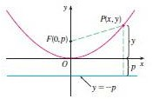
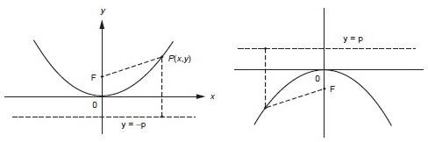
and the distance from P to the directrix is |𝑦 + 𝑝|
The defining property of a parabola is that these distances are equal:
√𝑥² + (𝑦 − 𝑝)² = |𝑦 + 𝑝|
We get an equivalent equation by squaring and simplifying:
𝑥² + (𝑦 − 𝑝)² = |𝑦 + 𝑝|² = (𝑦 + 𝑝)²
𝑥² + 𝑦² − 2𝑝𝑦 + 𝑝² = 𝑦² + 2𝑝𝑦 + 𝑝²
𝑥² = 4𝑝𝑦
An equation of the parabola with focus (0,p) and directrix y = - p is
x² = 4py
The distance between the focus and the vertex, or vertex and directrix, is denoted by p (> 0) and leads to one of the following equations of a parabola with vertex at the origin.
𝑥² = 4𝑝𝑦 , 𝑝 > 0
𝑥² = 4𝑝𝑦 , 𝑝 < 0

Slide 6
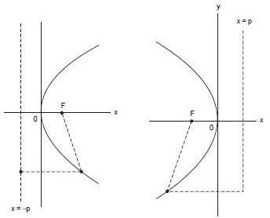
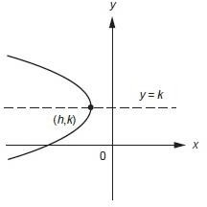
𝑦² = 4𝑝𝑥 , 𝑝 > 0 𝑦² = 4𝑝𝑥 , 𝑝 < 0
For each of the four orientations shown in Figures, the corresponding parabola with vertex (h, k) is obtained by replacing x by x – h
and y by y – k. Thus, the parabola in Figure below has the equation
(𝑦 − 𝑘)² = −4𝑝(𝑥 − ℎ)

Slide 7
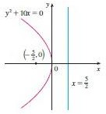
Example
Find the focus and directrix of the parabola y² + 10 x = 0 and sketch the graph.
Solution
If we write the equation as y² = - 10 x and compare it with Equation, we see that 4p = - 10 , so p = -5/2. Thus the focus is (p,0) = (-5/2, 0 )and the directrix is x = 5/2 .
The sketch is shown in Figure below
Ellipse
An ellipse is the set of all points in the plane such that the sum of their distances from two fixed points, called foci, is a given constant 2a. The distance between the foci is denoted 2c; the length of the major axis is 2a, whereas the length of the minor axis is 2b. The eccentricity of an ellipse, e, is < 1.

Slide 8
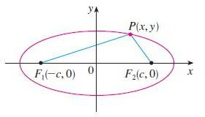
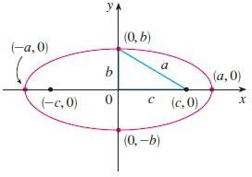
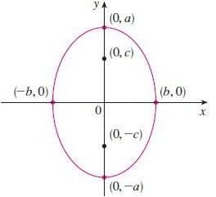
The x-intercepts are found by setting y = 0. Then x²/a² = 1, or 𝑥² = 𝑎² , so 𝑥 = ∓𝑎 . The corresponding points (a,0) and (-a,0) are called the vertices of the ellipse and the line segment joining the vertices is called the major axis. To find the y-intercepts we set x = 0 and obtain 𝑦² = 𝑏², so 𝑦 = ∓𝑏. The line segment joining (0,b) and (0,-b) is the minor axis.
We summarize this discussion as follows
1- The ellipse has foci (∓𝒄, 𝟎), 𝒘𝒉𝒆𝒓𝒆 𝒄^{𝟐} = 𝒂^{𝟐} − 𝒃^{𝟐}, 𝒂𝒏𝒅 𝒗𝒆𝒓𝒕𝒊𝒄𝒆𝒔 (∓𝒂, 𝟎)
_{𝒙}𝟐 _{𝒚}𝟐
_{𝒂𝟐} + _{𝒃𝟐} = 𝟏
𝒂 ≥ 𝒃 > 0
2- The ellipse has foci (𝟎, ∓𝒄), 𝒘𝒉𝒆𝒓𝒆 𝒄^{𝟐} = 𝒂^{𝟐} − 𝒃^{𝟐}, 𝒂𝒏𝒅 𝒗𝒆𝒓𝒕𝒊𝒄𝒆𝒔 (𝟎, ∓𝒂)
_{𝒙}𝟐 _{𝒚}𝟐
_{𝒃𝟐} + _{𝒂𝟐} = 𝟏
𝒂 ≥ 𝒃 > 0

Slide 9
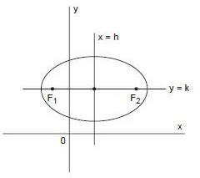
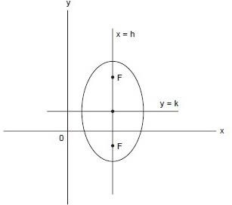
An ellipse with center at point (h, k) and major axis parallel to the x-axis is given by the equation
(𝒙 − 𝒉)^{𝟐} (𝒚 − 𝒌)^{𝟐}
+ = 𝟏
_{𝒂}𝟐 _{𝒃}𝟐
An ellipse with center at (h, k) and major axis parallel to the y-axis is given by the equation
(𝒚 − 𝒌)^{𝟐} (𝒙 − 𝒉)^{𝟐}
+ = 𝟏
_{𝒂}𝟐 _{𝒃}𝟐

Slide 10
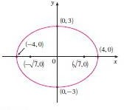
Example Sketch the graph of 9𝑥² + 16𝑦² = 144 and locate the foci.
Solution Divide both sides of the equation by 144:
_{𝑥}2 _{𝑦}2
+ = 1
16 9
The equation is now in the standard form for an ellipse, so we have a² = 16, b² = 9, a = 4, and b = 3. Also, c² = a² – b² = 7, so c =
√7 , the foci are (∓√7, 0). The graph is sketched as
Example Find an equation of the ellipse with foci (0, ∓2) and vertices (0, ∓3).
Solution we have c = 2 and a = 3. Then we obtain 𝑏² = a² − c² = 9 − 4 = 5 , so an equation of the ellipse is
_{𝑥}2 _{𝑦}2
+ = 1
5 9
Another way of writing the equation is 9𝑥² + 5𝑦² = 45.

